Slide 1

Shopping Cart Application Capstone
Presented by Rosa Garcia

Slide 2
Overview
Requirements
Planning
Backend
Frontend
UI
Demonstration
Questions
Retrospection

Slide 3

Requirements
A Full-stack, e-commerce type application
Front-end using Angular
Back-end using Java with Spring Boot and JPA, and backed by a MySQL database
Items should have a name, price, domestic/imported distinction, and category, and be of type Book, Food, Medical, Music, Luxury, or Clothes.
A sales tax of 10% applies on all goods except Books, Food, Medical Supplies. An import duty is applied to all import items at a rate of 5%, no exemptions.
Users should be able to search/filter goods based on name or product category.
Users need to be able to add or remove items in various quantities to and from their shopping cart.
When the user clicks "Purchase", they should receive a receipt of the purchase.

Slide 4


Planning
POSH OPTION – The word “shop” is in our name.
Posh Option is an online emporium that sells books, food, music, luxury items, and clothes.
Based on the “posh” image of the site, 36 items (6 for each category) were chosen that would appeal to users with discerning and varied tastes.
Among the items available are
best-selling books and music CDs
Asian and European snacks
European perfumes, scarves, and leather bags
Common medicinal products
Business casual attire

Slide 5

Backend
Back-end using Java with Spring Boot and JPA, and backed by a MySQL database
Item DTO – contains the properties for Item that will be used by the database table and maps the database table to the Item DTO
Receipt Class – contains the properties for Receipt used in calculating the item tax and total
Item DAO (Repository) – gets the table data from SQL to the application
Item Service – contains CRUD functionality as well as the function for calculating tax and total
Item Controller – handles the client requests and contains the request mapping
MySQL shopping cart database with 36 item entries

Slide 6
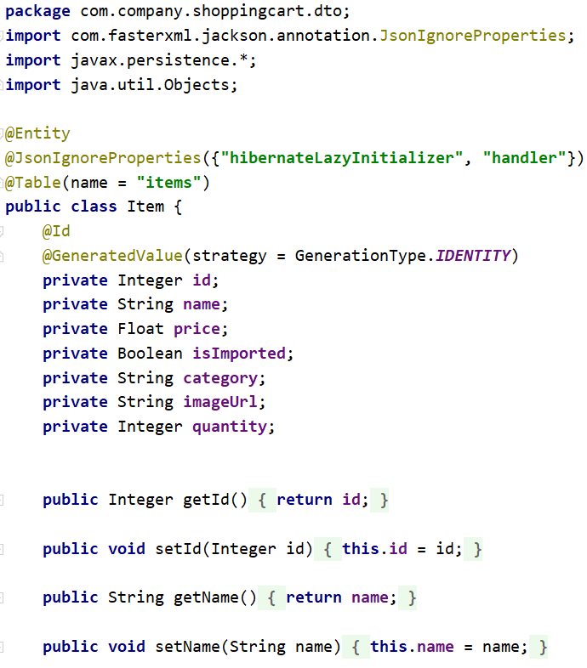
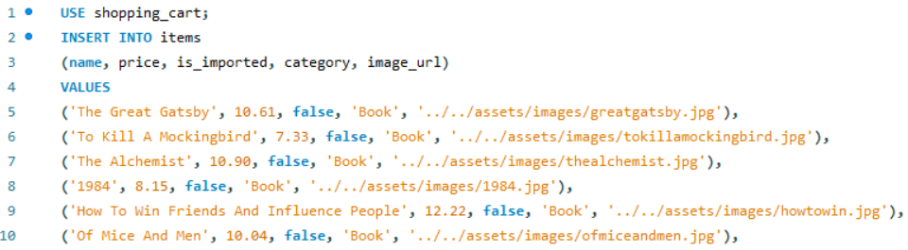
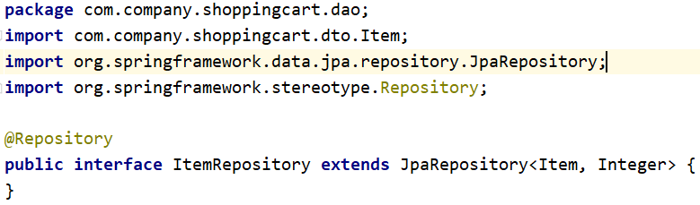
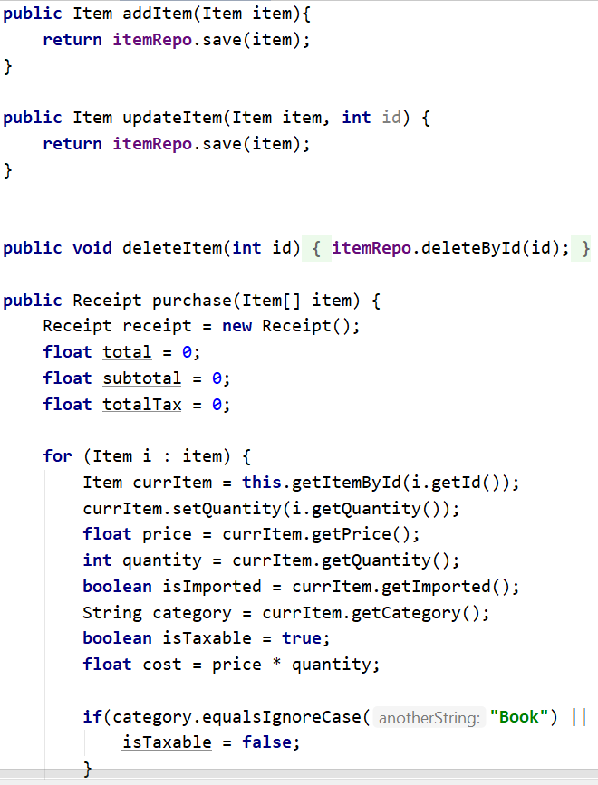
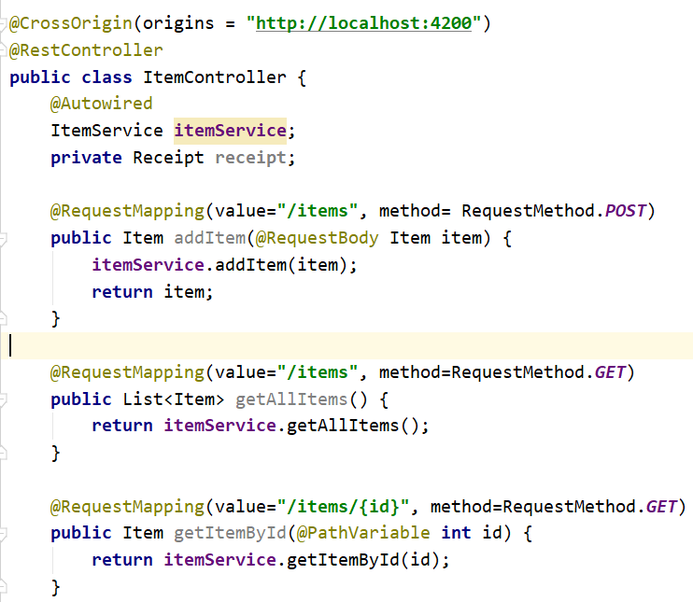
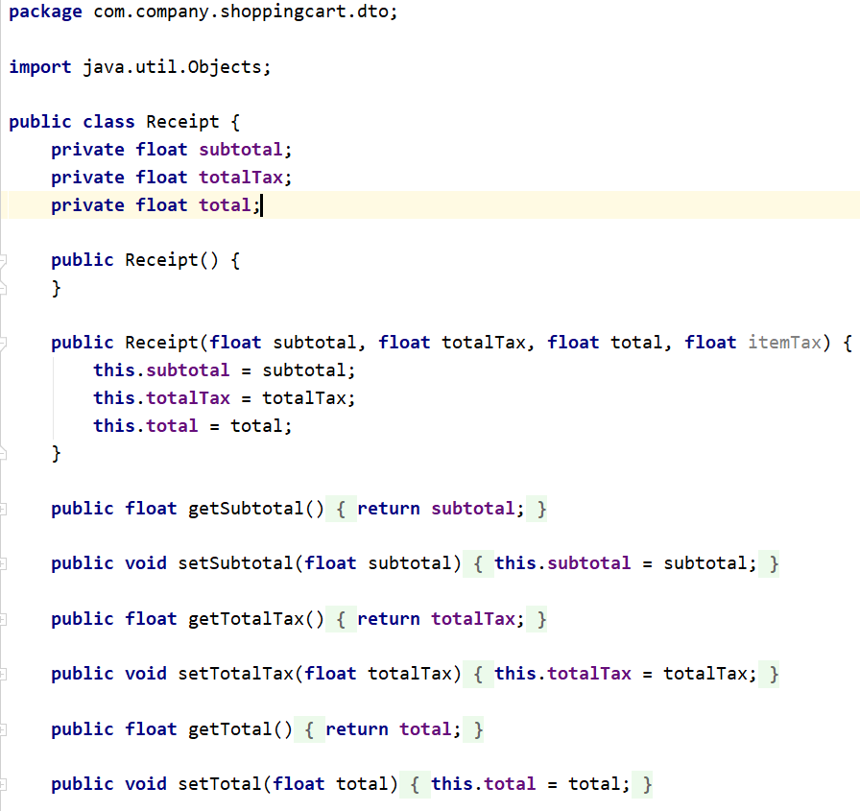
Shopping Cart Table
Item DAO
Item Service
Item DTO
Item Controller
Receipt Class

Slide 7

Frontend
Front-end using Angular
1 App Module
2 Classes
Item
Receipt
6 Components
Checkout – displays the user purchase
Home – displays the home page
Items (master) – displays the items list
Item Card (detail) – displays the cards for each item
Navbar – displays navigation at the top of page
Page not found – displays Not Found page when link does not exist
3 Services
Items – retrieves the items and the receipt calculations from the server
Cart – adds or deletes items from checkout
Transaction – used by the Items service for the purchases

Slide 8
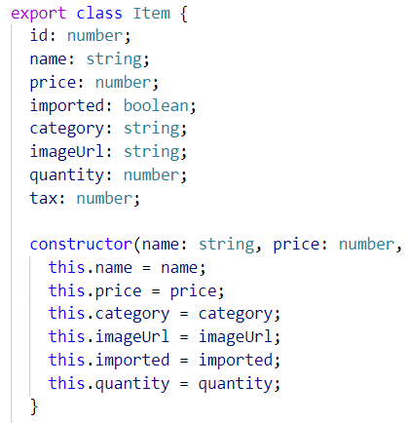
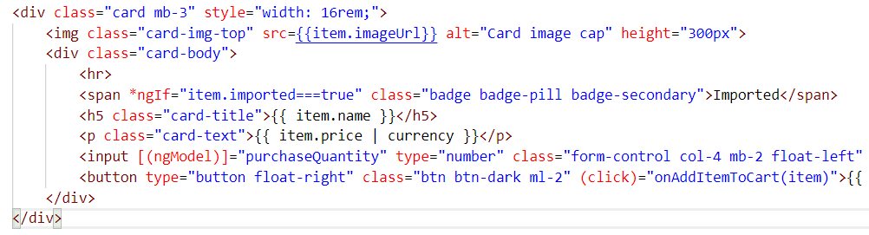
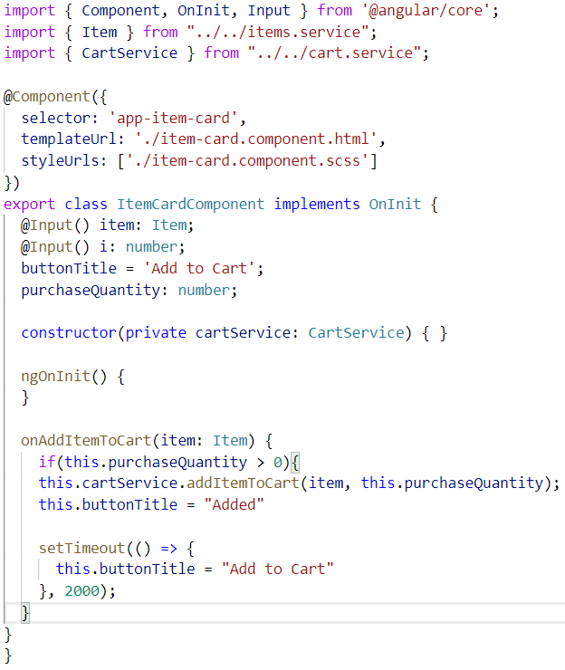
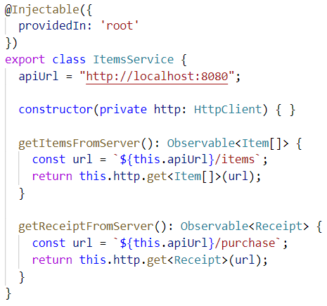
Item Class
Item Card HTML
Item Card TS
Items Service

Slide 9
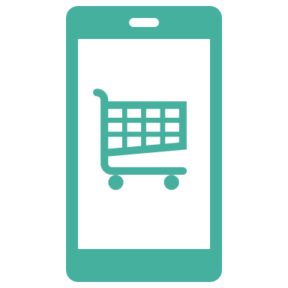
User Interface
A Responsive UI with a minimalistic design using Twitter Bootstrap
Homepage provides information about the company and displays some of the categories
Users can search by item name or item category in the Items page
Users can update their quantity before checkout
Users can delete items from cart
Users can see itemized totals with tax before purchase

Slide 10
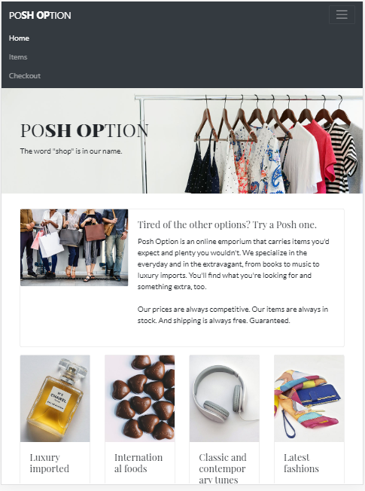
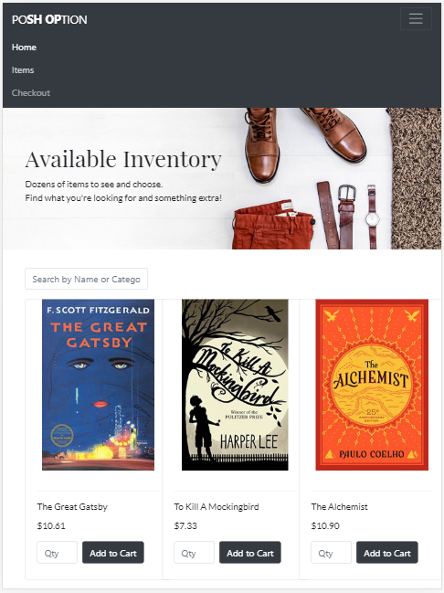
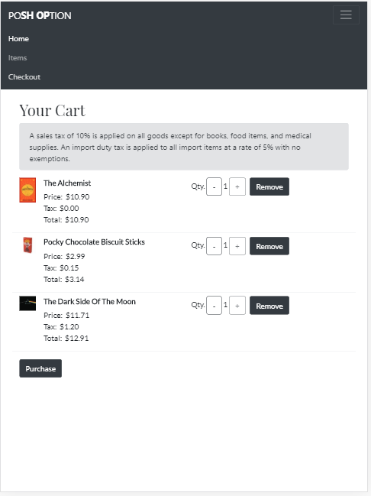
Homepage
Items Page
Checkout Page

Slide 11

Retrospection
Technical Insight
My primary technical learning was understanding how to communicate between the backend to the frontend
Challenges
In Capstone 1, I learned how to create a backend that displayed CRUD functions on a mock client.
In Capstone 2, I used what I learned in Capstone 1 to build the backend, but had trouble getting the data from the backend to the frontend:
Getting all items
Sending back user input
Getting tax and total results
Other challenges included being able to update the quantity without a fixed amount
Technical Insight
Challenges
Possible Changes

Slide 12
Retrospection
Possible changes
Add more features
an items detail component to display item information
an admin component to add/delete/update items
navigation by category via button click versus search field
a footer
With more time and money, I’d like to
add a User component to store user information and show purchase history
update the UI to have a more custom design
Technical Insight
Challenges
Possible Changes

Slide 13

Demonstration

